Slide 2
The Need to Improve Science Education: Why Now? An Overview

Slide 3
Science Skills are in Demand
Students will face unprecedented competition in the workforce not only within their home states, but also from foreign countries.
By 2015, nearly 60% of the new jobs being created will require skills currently being mastered by only 20% of the population, according to a recent report from the American Society for Training and Development.
According to the same report, job skills in STEM—science, technology, engineering and math—are among the skills experiencing the greatest increase in demand. In 1991, fewer than 50% of U.S. jobs required skilled workers. By 2015, 76% of all newly created U.S. jobs will require highly-skilled workers, with some proficiency in STEM.

Slide 4
Science Literacy in the 21st Century
The definition of what it means to be “literate” in science continues to grow and includes the use of technology, critical thinking and analytical skills.
As citizens, we are increasingly asked to make decisions on issues ranging from healthcare to the environment, where literacy in science is essential.
Science literacy and the skills developed in the science classroom will help students improve performance and understanding in other subjects, including math and reading.

Slide 5
U.S. Students are Lagging Behind
According to 2012 results from the Program for International Student Assessment (PISA), U.S. students ranked 20th in science compared to their peers in other countries.
According to a 2011 ACT report, only 30% of U.S. high school graduates in 2011 were ready for college coursework in science.
Notes:
.

Slide 6
State Science Standards are Out of Date
It has been more than 17 years since the National Research Council and the American Association for Advancement of Science produced their reports from which most state science standards are based.
Since then, major advances in science and our understanding of how students learn science have taken place and need to be reflected in state standards.

Slide 7
Since States Last Updated their Science Standards…
GPS goes mainstream
Text messaging introduced by AT&T
Pluto is reclassified as a dwarf planet
Apple releases the iPhone
NASA Rovers discover evidence of water on Mars
Robotic limbs with advanced movement by connecting electrodes and wires to human nerve endings
Creation of the first synthetic genome for a bacterial cell
Google was founded

Slide 8
Strong Science Education = College and Career Readiness
A high-quality, robust science education means students learn more and will develop skills -- communication, collaboration, inquiry, problem-solving, flexibility -- that will serve them throughout their educational and professional lives.
Teachers who apply the principles of high quality STEM instruction are able to teach students in the ways they learn best – in a hands-on, collaborative, and integrated environment rooted in inquiry and discovery.

Slide 9
The History of
Standards

Slide 10
History of State Standards
State standards have been part of the education policy landscape for more than 20 years.
1983: A Nation at Risk issues a call to arms for state leaders to raise the expectations for their education systems — the defining moment for the standards-based education reform movement.
1989: Education Summit establishes education goals in core subject areas and calls on states to set academic standards as a first step in restructuring K–12 education systems.
By 2000: Nearly every state has developed standards in core subject areas, and many have revised standards at least once.

Slide 11
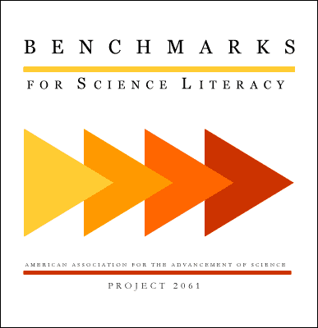
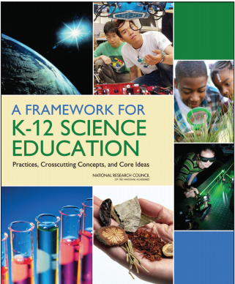
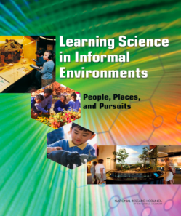
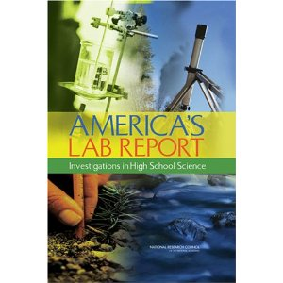
Evolution of State Science Standards
Phase I
Phase II
1990s
1990s-2009
7/2010 – April 2013
1/2010 - 7/2011

Slide 12
Purpose of State Standards
Assessments
Curricula
Instruction
Teacher development

Slide 13
Developing the NGSS

Slide 14
Partners in the Development of the Framework and NGSS
Notes:
Achieve is a bipartisan, non-profit organization that helps states raise academic standards, improve assessments, and strengthen accountability to prepare all young people for postsecondary education, work, and citizenship. Achieve, was established in 1996 at the National Education Summit by a bipartisan group of governors and corporate leaders with the purpose of supporting standards-based education reform efforts across the states.
The National Academy of Sciences, National Academy of Engineering, Institute of Medicine, and National Research Council are private, nonprofit institutions that provide expert advice on some of the most pressing challenges facing the nation and the world. Known collectively as the National Academies, our organization produces groundbreaking reports that have helped shape sound policies, inform public opinion, and advance the pursuit of science, engineering, and medicine. NAS is not a federal governmental agency; this is an important point especially with this project. It brings together committees of experts across areas of scientific and technological endeavor to address critical national issues and provides advice to the federal government and the public.
The American Association for the Advancement of Science, "Triple A-S" (AAAS), is an international non-profit organization dedicated to advancing science around the world by serving as an educator, leader, spokesperson and professional association. In addition to organizing membership activities, AAAS publishes the journal Science, as well as many scientific newsletters, books and reports, and spearheads programs that raise the bar of understanding for science worldwide.
The National Science Teachers Association (NSTA), is the largest organization in the world committed to promoting excellence and innovation in science teaching and learning for all. NSTA's current membership of 60,000 includes science teachers, science supervisors, administrators, scientists, business and industry representatives, and others involved in and committed to science education.

Slide 15
By States, For States
The NGSS are a new set of K-12 science education standards developed by states, for states.
The NGSS identify science and engineering practices and content that all K-12 students should master in order to be prepared for success in college and 21st-century careers.
The NGSS are based on A Framework for K-12 Science Education developed by the National Research Council.

Slide 16
By States, For States
The NGSS were built upon a vision for quality science education for ALL students, not just a select few.
The NGSS are not curricula. The standards articulate what students need to know and be able to do by the end of each grade level.
The NGSS were benchmarked against countries whose students perform well in science and engineering.
Notes:
Bullet #2 -- Districts, schools, and classroom teachers will determine their own curriculum, including what is taught throughout the year and how it is taught.
Bullet #3-- Countries include: Finland, South Korea, China, Canada, England, Hungary, Ireland, Japan and Singapore.

Slide 17
Process for Development of Next Generation Science Standards
States and other key stakeholders were engaged in the development and review of the NGSS
State-Led Process
26 Volunteer Lead State Partners
Writing Team
41 educators, scientists, and engineers from across the country
Critical Stakeholder Team
Education, science, business and industry, as well as the general public -- including, in some cases, parents and students.
Notes:
States volunteered to be Lead State Partners for the development of the NGSS by way of a state partnership agreement signed by their chief state school officer and state board of education chair. The agreement included a commitment by states to convening, in-state, broad-based committee(s) ranging from 50 to 150 members to provide feedback and guidance to the state throughout the process. Twenty-six states signed on to be Lead State Partners.
The writing team is truly led by the education community– most specifically K-12 educators and administrators that are in the classroom every day. The utility of the document is paramount and if the resulting standards aren’t useful in application, we would consider them a failed initiative.
Members of the writing team represent elementary, middle, and high school educators in both urban and rural communities. This prestigious group includes State Teachers of the Year, Einstein Fellows, Presidential Award for Excellence in Mathematics and Science Teaching winners and individuals who hold offices in their respective professional organizations.
The critical stakeholder team participated in all state and public reviews and The Critical Stakeholders are distinguished individuals and organizations that represent education, science, business and industry and who have interest in the Next Generation Science Standards. The members are drawn from all 50 states and have expertise in: Elementary, middle and high school science from both urban and rural communities
Special education and English language acquisition, Postsecondary education, State standards and assessments, Cognitive science, life science, physical science, earth/space science, and engineering/technology, Mathematics and Literacy, Business and industry, Workforce development, and Education policy

Slide 18
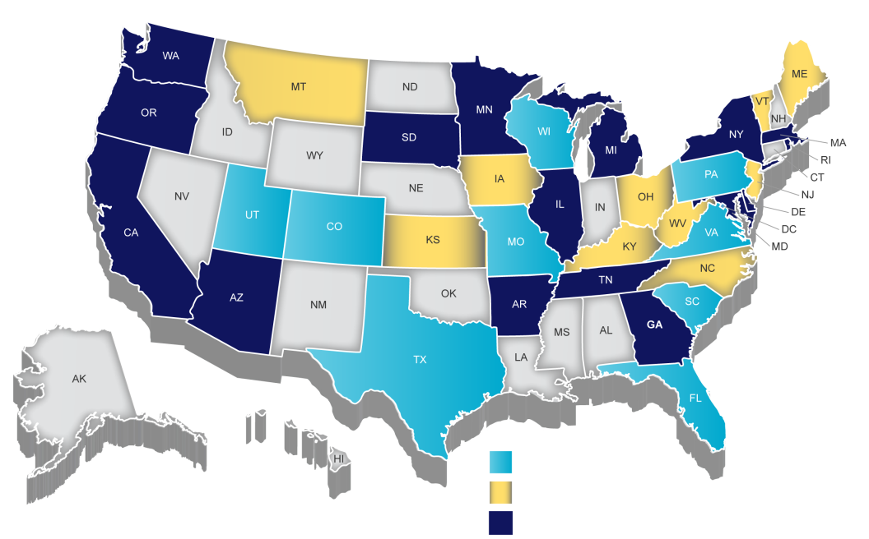
Lead State Partners and NGSS Writing Team
Writing Team Only
Lead State Partner Only
Lead State Partner and Writing Team

Slide 19
Incorporating Feedback
3 State and Critical Stakeholder Review Periods
Winter 2012, Fall 2012, Winter 2013
2 Public Review Periods
Spring 2012, Winter 2013
The draft standards received comments from more than 10,000 individuals

Slide 20
Release and Adoption
The NGSS were released April 2013 after passing a fidelity review by the National Research Council which ensured the NGSS were consistent with the vision outlined in A Framework for K-12 Science Education.
As of January 2016, 16 states and the District of Columbia have adopted: Arkansas, California, Connecticut, Delaware, Illinois, Iowa, Kansas, Kentucky, Maryland, Michigan, New Jersey, Nevada, Oregon, Rhode Island, Vermont and Washington.

Slide 21
A Framework for K-12 Science Education

Slide 22
Framework Vision (Summary)
New learning builds on previous knowledge, skills and instruction
Focuses on a limited number of core ideas, but each in greater depth
Emphasizes integration of content knowledge and the practices
Notes:
First, it is built on the notion of learning progressions as a developmental progression.
Second, the framework focuses on a limited number of core ideas in science and engineering both within and across the disciplines.
Third, the framework emphasizes that learning about science and engineering involves integration of the knowledge of scientific explanations (i.e., content knowledge) and the practices needed to engage in scientific inquiry and engineering design.

Slide 23
Principles of the Framework
Children are born investigators
Understanding builds over time
Science and engineering require both knowledge and practice
Connecting to students’ interests and experiences is essential
Focusing on core ideas and practices
Promoting equity

Slide 24
Scientific and Engineering Practices

Slide 25
Scientific and Engineering Practices
Asking questions and defining problems
Developing and using models
Planning and carrying out investigations
Analyzing and interpreting data
Using mathematics, information and computer technology, and computational thinking
Constructing explanations and designing solutions
Engaging in argument from evidence
Obtaining, evaluating, and communicating information
Framework pp.41-82
Notes:
These are not simply teaching strategies. They also represent a body of knowledge that represent how scientists accumulate and communicate knowledge.

Slide 26
Crosscutting Concepts

Slide 27
Crosscutting Concepts
Patterns
Cause and effect
Scale, proportion, and quantity
Systems and system models
Energy and matter
Structure and function
Stability and change
Framework pp.83-102

Slide 28
Disciplinary Core Ideas

Slide 29
Disciplinary Core Ideas
Life Science
LS1: From Molecules to Organisms: Structure and Processes
LS2: Ecosystems: Interactions, Energy, and Dynamics
LS3: Heredity: Inheritance and Variation of Traits
LS4: Biological Evolution: Unity and Diversity
PS4: Waves and Their Applications in Technologies for Information Transfer
PS3: Energy
PS2: Motion and Stability: Forces and Interactions
PS1: Matter and Its Interactions
Physical Science

Slide 30
Disciplinary Core Ideas (cont.)
Earth and Space Science
ESS1: Earth’s Place in the Universe
ESS2: Earth’s Systems
ESS3: Earth and Human Activity
Engineering, Technology, and Applications of Science
ETS1: Engineering Design
ETS2: Links Among Engineering, Technology, Science, and Society

Slide 31
What’s Different about the Next Generation Science Standards?

Slide 32
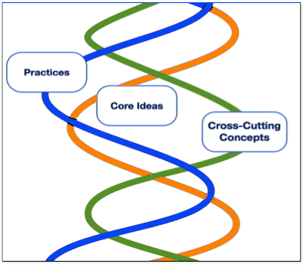
Three Dimensions Intertwined
Performance Expectations
The Framework requires contextual application of the three dimensions by students.
Focus is on how and why as well as what
Notes:
The NGSS require students to operate at the Nexus of the three dimensions.

Slide 33
Current State Science Standard Sample
Inquiry Standards
Content Standards
Distinguish between atoms and molecules.
Describe the difference between pure substances (elements and compounds) and mixtures.
Describe the movement of particles in solids, liquids, gases, and plasmas states.
Distinguish between physical and chemical properties of matter as physical (i.e., density, melting point, boiling point) or chemical (i.e., reactivity, combustibility).
Distinguish between changes in matter as physical (i.e., physical change) or chemical (development of a gas, formation of precipitate, and change in color).
Recognize that there are more than 100 elements and some have similar properties as shown on the Periodic Table of Elements.
Identify and demonstrate the Law of Conservation of Matter.
Students will explore the importance of curiosity, honesty, openness, and skepticism in science and will exhibit these traits in their own efforts to understand how the world works.
Students will use standard safety practices for all classroom laboratory and field investigations.
Students will have the computation and estimation skills necessary for analyzing data and following scientific explanations.
Students will use tools and instruments for observing, measuring, and manipulating equipment and materials in scientific activities utilizing safe laboratory procedures.
Students will use the ideas of system, model, change, and scale in exploring scientific and technological matters.
Students will communicate scientific ideas and activities clearly.
Students will question scientific claims and arguments effectively.
Notes:
Most existing state standards have a separate set of standards for inquiry and content. Typically that leads to only content being tested and no guidance to teachers regarding integration of practice with content.

Slide 34
Standards Comparison: Structure and Properties of Matter
Current State Middle School Science Standard
Distinguish between atoms and molecules.
Describe the difference between pure substances (elements and compounds) and mixtures.
Describe the movement of particles in solids, liquids, gases, and plasmas states.
Distinguish between physical and chemical properties of matter as physical (i.e., density, melting point, boiling point) or chemical (i.e., reactivity, combustibility).
Distinguish between changes in matter as physical (i.e., physical change) or chemical (development of a gas, formation of precipitate, and change in color).
Recognize that there are more than 100 elements and some have similar properties as shown on the Periodic Table of Elements.
Identify and demonstrate the Law of Conservation of Matter.
Notes:
Comparing these middle school content standards with middle school NGSS in the same concept.
Substitute state standards for these.
Draw attention to the verbs. They are all low level verbs.

Slide 35
Standards Comparison: Structure and Properties of Matter
NGSS Middle School Sample
Students who demonstrate understanding can:
Develop models to describe the atomic composition of simple molecules and extended structures.
Analyze and interpret data on the properties of substances before and after the substances interact to determine if a chemical reaction has occurred.
Gather and make sense of information to describe that synthetic materials come from natural resources and impact society.
Develop a model that predicts and describes changes in particle motion, temperature, and state of a pure substance when thermal energy is added or removed.
Develop and use a model to describe how the total number of atoms does not change in a chemical reaction and thus mass is conserved.
Undertake a design project to construct, test, and modify a device that either releases or absorbs thermal energy by chemical processes.*
Notes:
The verbs in the NGSS are the practices themselves. This requires a deeper level of knowledge on the part of the student.

Slide 36
Conceptual Shifts in the NGSS
K-12 science education should reflect the interconnected nature of science as it is practiced and experienced in the real World.
The Next Generation Science Standards are student performance expectations – NOT curriculum.
The science concepts build coherently from K-12.
The NGSS focus on deeper understanding of content as well as application of content.
Science and engineering are integrated in the NGSS from K–12.
NGSS content is focused on preparing students for the next generation workforce.
The NGSS and Common Core State Standards (English Language Arts and Mathematics) are aligned.

Slide 37
Moving from Standards to Instruction

Slide 38
Instruction Builds Toward PEs
Performance Expectation
Notes:
Instruction should build toward the performance expectations. They show what students should be able to do at the end of instruction, they are not what you teach. The picture shows that good NGSS instruction builds toward the PE and makes plenty of connections along the way.

Slide 39
Instructional Shifts in the NGSS
Focus on big picture, not lessons
New learning builds on previous knowledge, skills and instruction
Evidence of learning

Slide 40
Current and Upcoming NGSS Projects
Science EQuIP
Standards Comparison Tool
Evidence Statements
SciMath Tasks
Accelerated Model Course Maps
State of Science Education Research
Publishers Criteria
Model Content Frameworks

Slide 41
What’s Next in Our State?
Curriculum will be developed locally; classroom materials will be selected locally.
State and districts supporting schools and teachers in the upcoming transition to new standards
Professional development opportunities for teachers around higher expectations in K-12 science
Parents engaged early on about changes coming to science classrooms and how they can support students
Notes:
Tailor this slide to your state’s timeline. Include the academic year for implementation, specific districts holding PD and summer institutes, etc.

